Slide 1

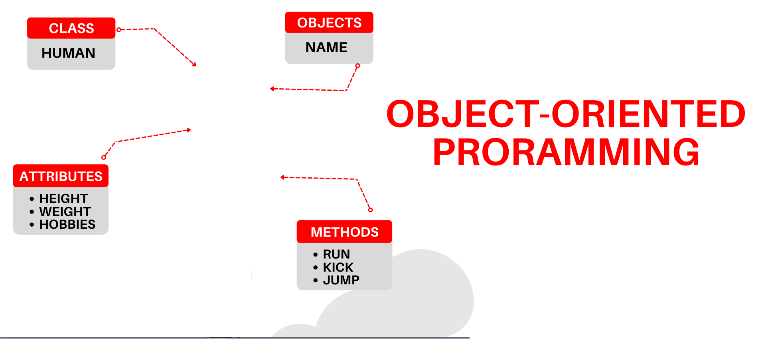

National University of Computer and Emerging Sciences
Spring 2022
Hira Naveed
Lecture # 2 Pointers

Slide 2
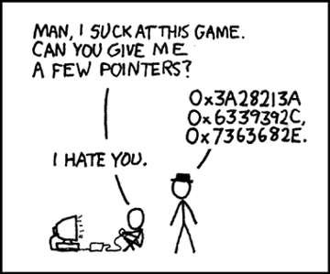
Pointers
Introduction
Address of and Dereference operator
Memory Leaks and dangling pointers
Void pointer
Casting pointers

Slide 3
Program Memory
Memory (RAM)
. | 1 Byte
.
204
205
206
207
208
209
210
211
.
.
Each block in memory represents 1 byte

Slide 4
Program Memory
Memory (RAM)
. | 1 Byte
.
204
205
206
207
208
209
210
211
.
.
Each block in memory represents 1 byte
Each byte in memory has an address
Whenever a variable is declared, the computer reserves some memory for it.

Slide 5
Program Memory
Memory (RAM)
. | 1 Byte
.
204
205 | $
206
207
208
209
210
211
.
.
Integers are stored in 4 bytes
Characters stored in 1 byte
int num = 100;
char letter = ‘$’;
100

Slide 6
Program Memory
Memory (RAM)
. | 1 Byte
.
204
205 | $
206
207
208
209
210
211
.
.
Integers are stored in 4 bytes
Characters stored in 1 byte
int num = 100;
char letter = ‘$’;
Can we find the memory address of these variables??
100

Slide 7
Program Memory
Memory (RAM)
. | 1 Byte
.
204
205 | $
206
207
208
209
210
211
.
.
Integers are stored in 4 bytes
int num = 100;
char letter = ‘$’;
Can we find the memory address of these variables??
cout<< &num;
100

Slide 8
Program Memory
Memory (RAM)
. | 1 Byte
.
204
205 | $
206
207
208
209
210
211
.
.
int num = 100;
char letter = ‘$’;
cout<< &num;
100
Variable Name | Data Type | Starting Address
num | int | 208
letter | char | 205

Slide 9
Program Memory
Memory (RAM)
. | 1 Byte
.
204
205 | $
206
207
208
209
210
211
.
.
int num = 100;
char letter = ‘$’;
cout<< &num; //prints 208
100
Variable Name | Data Type | Starting Address
num | int | 208
letter | char | 205

Slide 10

Pointer Variables
Pointer variable (pointer): a variable that holds an address
int x = 11;
cout<< &x;
dataType * variable Name;
int *ptr;
ptr = &x;
205 | int = 11
…
210

Slide 11
Pointer Variables
Pointer variable (pointer): a variable that holds an address
int x = 11;
cout<< &x;
int *ptr;
ptr = &x;
205 | x = 11
…
210 | ptr = 205

Slide 12
Pointer Variables
Because a pointer variable holds the address of another piece of data, it "points" to the data
int x = 11;
cout<< &x;
int *ptr;
ptr = &x;
205 | x = 11
…
210 | ptr = 205

Slide 13
The dereference Operator
The dereference operator (*) dereferences a pointer.
It allows you to access the value that the pointer points to. int x = 25; int *intptr = &x; cout << *intptr << endl;
This prints 25.

Slide 14
The dereference Operator
Note that the * sign can be confusing here, as it does two different things:
When used in declaration e.g. string* ptr, it creates a pointer variable.
When not used in declaration, it act as a dereference operator e.g cout << *ptr;

Slide 15
The dereference Operator
Another Example:
int v1 = 99;
int* p = &v1;
cout<<“ P points to the value: “<< *p;

Slide 16
Dereferencing Pointer Example
int v1 = 0; int* p1 = &v1; *p1 = 42; cout << v1 << endl; cout << *p1 << endl;
v1 and *p1 now refer to the same variable
Output:
42
42

Slide 17
Pointer Assignment and Dereferencing
Assignment operator ( = ) can be used to assign value of one pointer to another
Pointer stores addresses so p1 = p2 copies an address value into another pointer
int v1 = 55; int* p1 = &v1; int* p2;
p2=p1; cout << *p1 << endl; cout << *p2 << endl;
Output:
55
55

Slide 18
Dynamic Memory Allocation
Used when space requirements are unknown at compile time
Most of the time the amount of space required is unknown at compile time
Dynamic Memory Allocation (DMA):-
We can allocate/deallocate memory at runtime or execution time.

Slide 19
Differences between Static and Dynamic Memory Allocation
Dynamically allocated memory is kept on the memory heap (also known as the free store)
Dynamically allocated memory cannot have a name, it must be referred to
Declarations are used to statically allocate memory,
the new operator is used to dynamically allocate memory

Slide 20
Dynamic Memory Allocation
Heap management in C++ is explicit:
ptr = new datatype;
//allocate memory for one element
ptr = new datatype[size];
//allocate memory for fixed number of elements

Slide 21
Dynamic Memory Allocation
Heap management in C++ is explicit:
delete ptr;
//deallocate memory for one element
delete [] ptr;
//deallocate memory for array

Slide 22
Example
int main()
{
int *p;
p = new int;
*p = 99;
return 0;
}
0
text
data
bss
heap
#@%*&
p
0xffffffff
stack

Slide 23
Example
int main()
{
int *p;
p = new int;
*p = 99;
return 0;
}
0
text
data
bss
heap
99
p
0xffffffff
stack

Slide 24
Aliasing
If two pointers have the same value, they are aliases of each other.
int main()
{
int *p, *q;
p = new int;
*p = 99;
q = p;
return 0;
}
0
text
data
bss
heap
99
q
p
0xffffffff
stack

Slide 25
Aliasing
If two pointers have the same value, they are aliases of each other.
int main()
{
int *p, *q;
p = new int;
*p = 99;
p = q;
*q = 88;
return 0;
}
0
text
data
bss
heap
99
q
p
0xffffffff
stack

Slide 26
Aliasing
If two pointers have the same value, they are aliases of each other.
int main()
{
int *p, *q;
p = new int;
*p = 99;
q = p;
*q = 88;
return 0;
}
0
text
data
bss
heap
88
q
p
0xffffffff
stack

Slide 27
Dangling Pointers
int main()
{
int *p, *q;
p = new int;
*p = 99;
p = q;
*q = 88;
delete q;
return 0;
}
0
text
data
bss
heap
88
q
p
0xffffffff
stack

Slide 28
Dangling Pointers
int main()
{
int *p, *q;
p = new int;
*p = 99;
p = q;
*q = 88;
delete q;
return 0;
}
0
text
data
bss
heap
$%#^&
q
p
0xffffffff
stack

Slide 29
Dangling Pointers
p and q are now dangling pointers but why..?
int main()
{
int *p, *q;
p = new int;
*p = 99;
p = q;
*q = 88;
delete q;
*p = 71;
return 0;
}
0
text
data
bss
heap
$%#^&
q
p
0xffffffff
stack

Slide 30
Dangling Pointers
The delete operator does not delete the pointer, it takes the memory being pointed to and returns it to the heap
It does not even change the contents of the pointer
Since the memory being pointed to is no longer available (and may even be given to another application), such a pointer is said to be dangling

Slide 31

Errors due to Dangling Pointers
If the program writes to memory referenced by a dangling pointer, a silent corruption of unrelated data may result, leading to subtle bugs that can be extremely difficult to find

Slide 32
Avoiding a Dangling Pointer
For Variables:
delete v1;
v1 = NULL;
For Arrays:
delete[ ] arr;
arr = NULL;

Slide 33
Returning Memory to the Heap
Most applications request memory from the heap when they are running;
It is possible to run out of memory (you may even have gotten a message like "Running Low On Virtual Memory")
So, it is important to return memory to the heap when you no longer need it

Slide 34
Returning Memory to the Heap
Always return memory to the heap before undangling the pointer
What happens if you don’t?
ptr = NULL;
delete ptr;
Memory Leak!!!

Slide 35
Memory Leaking
int main()
{
int *p;
p = new int;
// memory allocated above is unreachable now
p = new int;
return 0;
}

Slide 36
Memory Leaking
p is a local variable, destroyed after function returns
void f()
{
int *p;
p = new int;
return;
}
int main()
{
f();
return 0;
}

Slide 37
Memory Leaks
Memory leaks when it is allocated from the heap using the new operator but not returned to the heap using the delete operator

Slide 38

Memory Leaking and Dangling Pointers
Dangling pointers and memory leaking are evil sources of bugs:
Hard to debug
may appear after a long time of run
may far from the bug point
Difficult to prevent

Slide 39
Null Address
Like a local variable, a pointer is assigned a random value (i.e., address) if not initialized
0 is a pointer constant that represents the empty or NULL address
Should be used to avoid dangling pointers
int *ptr = 0; OR int *ptr = NULL;

Slide 40
Null Address
Cannot Dereference a NULL Pointer
int *ptr = 0;
cout << *ptr << endl;
// ERROR: ptr does not point to a valid //address

Slide 41
Pointers Data-Type
Why does a pointer need a data type?
Aren’t all memory addresses of the same length?

Slide 42
Pointers Type
In a given OS, all memory addresses are of the same length
However, with operations like dereference or increment/decrement the compiler needs to know the data type of the pointer variable (to get data or jump to the next memory location)
Examples:
If “p” is a character-pointer then “p++” will increment “p” by one byte (next location)
if “p” is an integer-pointer its value on “p++” would be incremented by 4 bytes (next loc.)

Slide 43
Void Pointer
This is a great advantage…
So, What are the limitations?
void* is a pointer with no type:
void * can point at any type of data
int iVar=5;
float fVar=4.3;
char cVar=‘Z’;
int* p1;
void* vp2;
p1 = &iVar; // Allowed
p1 = &fvar; // Not Allowed
P1 = &cVar; // Not Allowed
vp2 = &fvar; // Allowed
vp2 = &cVar; // Allowed
vp2 = &iVar; // Allowed

Slide 44
Void Pointer
This is a great advantage…
So, What are the limitations?
void* is a pointer with no type:
void * can point at any type of data
Cannot be dereferenced
Cannot perform any arithmetic operations, not even increment/decrement

Slide 45
Casting pointers
Pointers have types, so you cannot just do this
int *pi;
double *pd;
pd = pi;
Even if they are both the same size, C++ will still give an error on implicit typecasting

Slide 46
Casting pointers
C++ will let you change the type of a pointer with an explicit cast
int *pi; char *pd;
pd = (char*) pi;
Notes:
int *ip; char* cp; double *dp;

